Slide 1

CSCE883 Machine Learning
Jianjun Hu
Department of Computer Science & Engineering
University of South Carolina

Slide 2
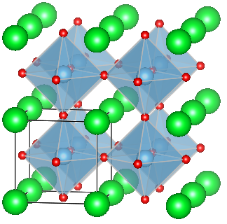
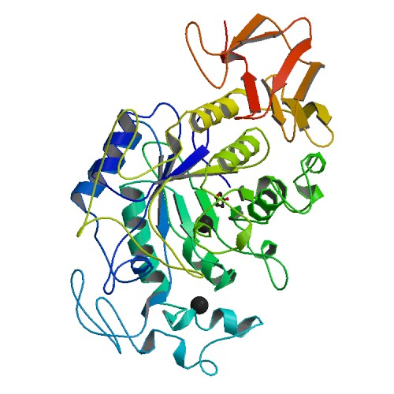
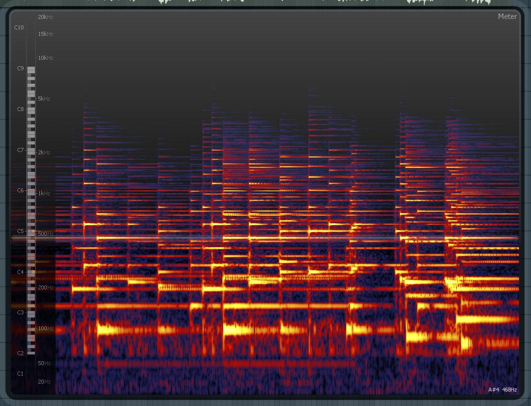
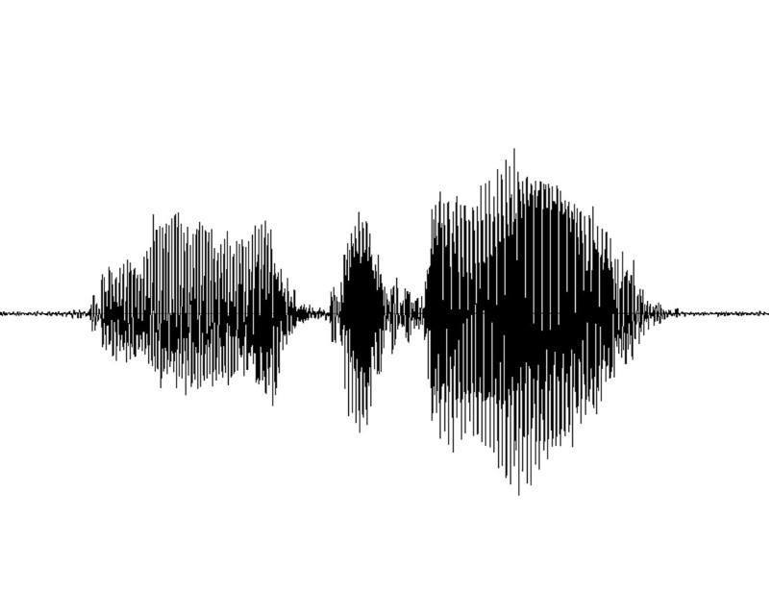
About Hu
Machine Learning and Evolution Laboratory
http://mleg.cse.sc.edu
Machine learning, evolutionary computation, data mining, Bioinformatics,material informatics, health informatics

Slide 3
Objectives of CSCE883
Exciting!
Useful!
Fun!
Something to show

Slide 4
Syllabus
https://sites.google.com/view/csce883
Office: 2240 innovation center
Office Hours: TTH 2:30PM-3:30PM or by Appointment (via zoom online)
4 homework, 1 mid-term exam, 1 final project
Textbook-must have
    Introduction to Machine Learning by Ethem Alpaydin
    (you can find cheap books at http://www.addall.com)
    https://github.com/janishar/mit-deep-learning-book-pdf
Grading: A/B/C/D/F

Slide 5
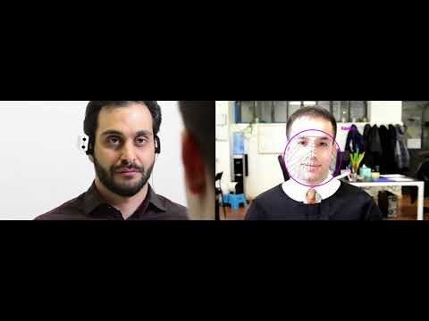
The deep learning revolution

Slide 6
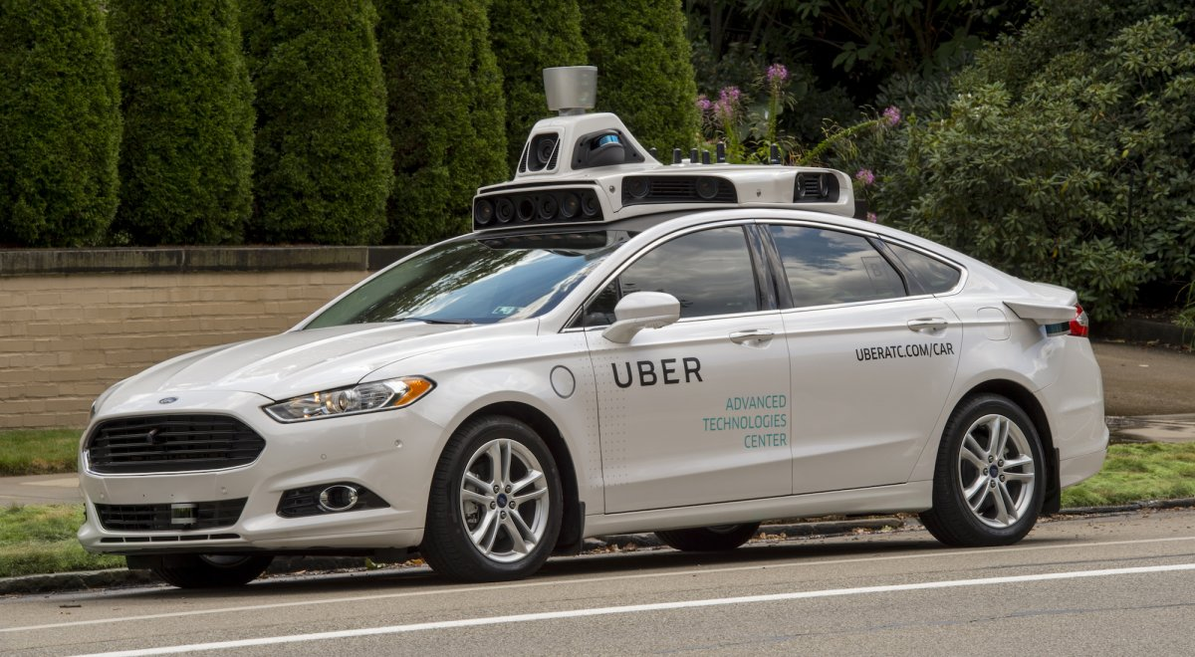
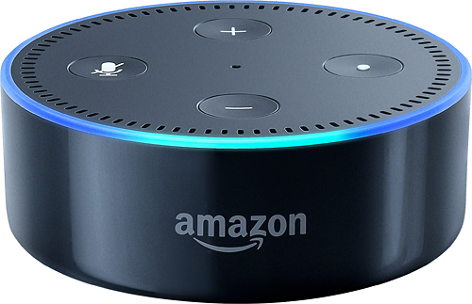



The AI revolution: The Big Picture
ChatGPT/Claude/AGI
Self-driving Car
Siri, Amazon Echo
Google Translation
AlphaGo
Robots
…

Slide 7
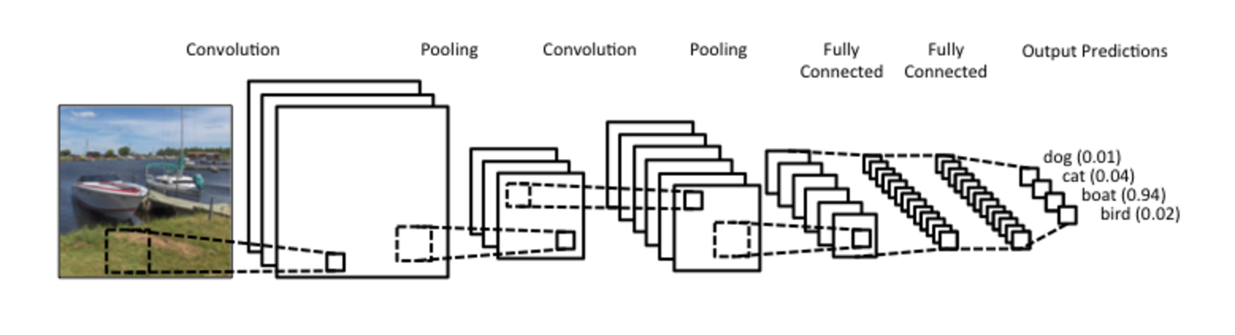
What is Deep Learning?
Deep Learning is a subfield of machine learning concerned with algorithms inspired by the structure and function of the brain called artificial neural networks

Slide 8
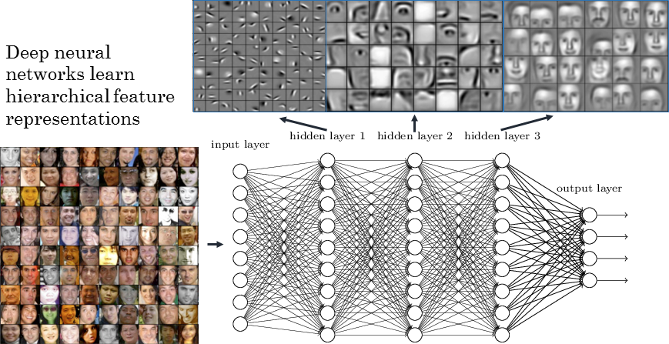
How it works: CNN+Backpropagation Algorithm
Representation Learning vs Feature Engineering

Slide 9
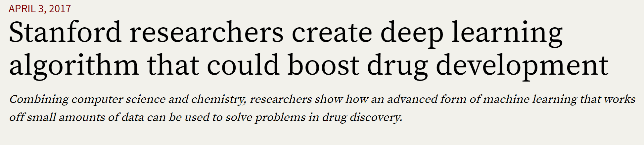
Breakthroughs by Deep Learning
Deep learning architectures such as deep neural networks, deep belief networks and recurrent neural networks have been applied to fields including computer vision, speech recognition, natural language processing, audio recognition, social network filtering, machine translation, bioinformatics and drug design^{[5]}, where they have produced results comparable to and in some cases superior^{[6]} to human experts

Slide 10
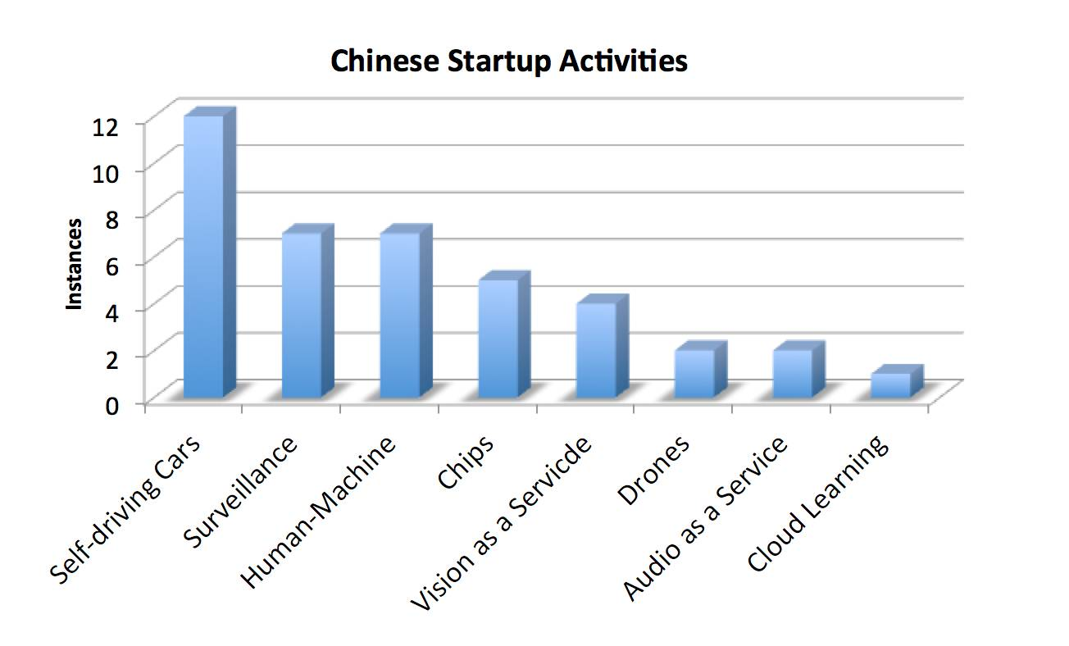
AI in China startups

Slide 11
AI companies
第四范式 | 成规模的深度学习云平台
思必驰 | 实时、基于云的自动语音识别，用于车载、智能家居和机器人 UI
寒武纪科技 | AI 设备及神经网络处理器
格灵深瞳 | 3D 计算机视觉和深度学习，用于人和车辆监测、追踪及识别
深鉴科技 | 压缩 CNN 网络和处理器
竹间智能 | 基于多模态的人机自然交互界面
旷视科技 | 人脸识别
地平线机器人 | 智能家居，自动驾驶和公共安全
碳云智能 | 基于机器的个性化健康分析和健康指数预测
云天励飞 | 基于云的深度学习，用于公共安全和工业监测
Minieye | ADAS 摄像头和软件
出门问问 | 智能手表，使用云进行语音搜索
Momenta | L5 无人驾驶 AI 平台
摩图科技 | 商业化计算机视觉和深度学习技术，用于低成本、低功耗平台
Rokid | 家庭智能助理– 自动语音识别技术 + face/gesture
中科视拓 | 赋能企业计算机视觉和机器学习的开源开发平台
商汤科技 | 计算机视觉
图普科技 | 图像识别技术和服务
图森科技 | 自动驾驶软件：检测和追踪，SLAM，图像分割、面部分析
云知声 | 基于 AI 的语音和文本识别
依图科技 | 用于安防、交通和医疗影像的计算机视觉
零零无限 | 智能无人机摄像头

Slide 12
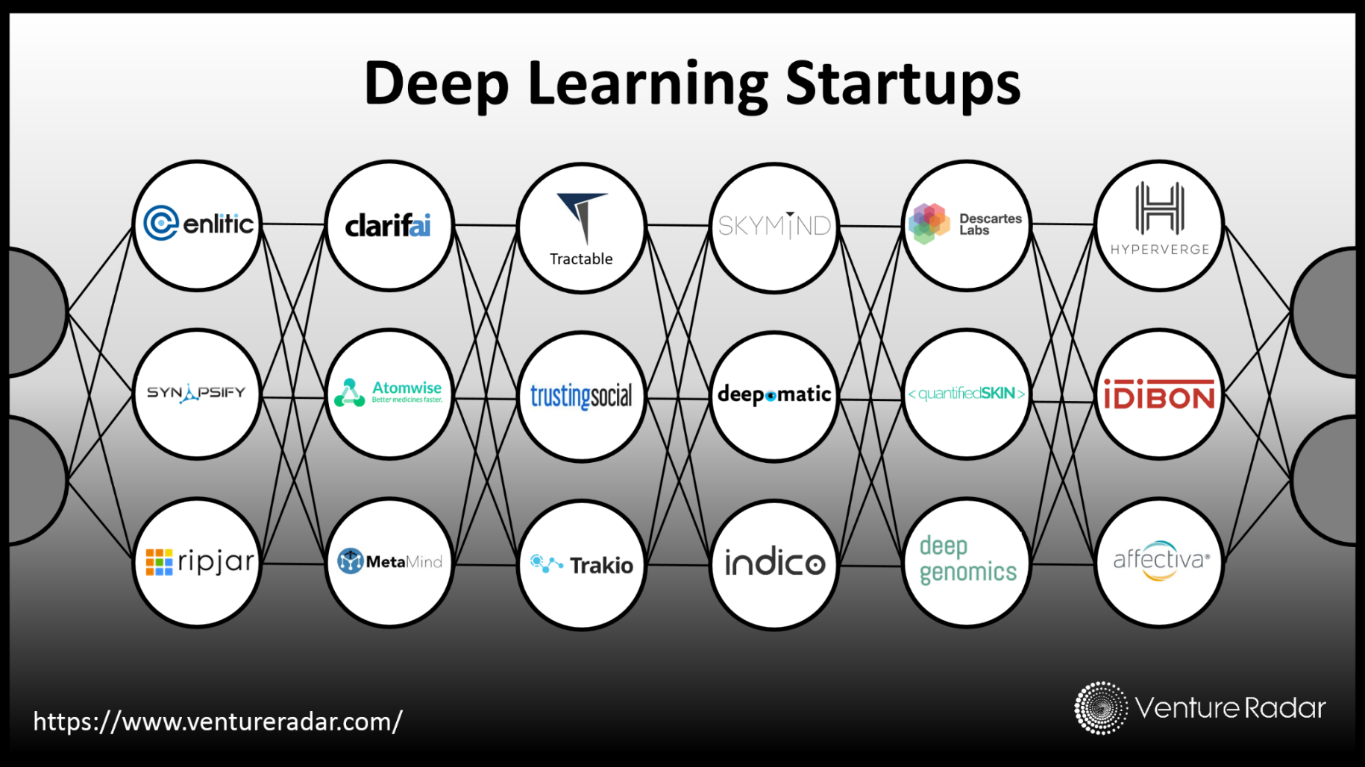
US startups

Slide 13
Keywords in AI/Computer Vision
Deep learning
DNN
CNN
GAN
RNN
ImageNet
Cifar
Tensorflow
Caffe
Torch
Theano
MxNet
Lecunn
Hinton
Feifei Li
Jian Sun
Bengio
Goodfellow
OpenAI
WaveNet
AGI
GRPO
The Deep Learning Revolution

Slide 14
What is Learning?
“Learning denotes changes in a system that ... enable a system to do the same task … more efficiently the next time.” - Herbert Simon
“Learning is constructing or modifying representations of what is being experienced.” - Ryszard Michalski
“Learning is making useful changes in our minds.” - Marvin Minsky
“Machine learning refers to a system capable of the autonomous acquisition and integration of knowledge.”

Slide 15
How human/animal learns?
Ride a bike
Recognize fruits
Play chess
Play piano
Play Poke
speaking
reading

Slide 16
So What Is Machine Learning?
Automating automation
Getting computers to program themselves
Writing software is the bottleneck
Let the data do the work instead!

Slide 17
Why Machine Learning?
No human experts
  industrial/manufacturing control
  mass spectrometer analysis, drug design, astronomic discovery
Black-box human expertise
  face/handwriting/speech recognition
  driving a car, flying a plane
Rapidly changing phenomena
  credit scoring, financial modeling
  diagnosis, fraud detection
Need for customization/personalization
  personalized news reader
  movie/book recommendation

Slide 18
Related Fields
data
mining
control theory
statistics
machine
learning
decision theory
information theory
cognitive science
databases
psychological models
evolutionary
models
neuroscience
Machine learning is primarily concerned with the accuracy and effectiveness of the computer system.

Slide 19
Types of Learning
Supervised (inductive) learning
  Training data includes desired outputs
Unsupervised learning
  Training data does not include desired outputs
Semi-supervised learning
  Training data includes a few desired outputs
Reinforcement learning
  Rewards from sequence of actions

Slide 20
Inductive Learning
Given examples of a function (X, F(X))
Predict function F(X) for new examples X
  Discrete F(X): Classification
  Continuous F(X): Regression
  F(X) = Probability(X): Probability estimation

Slide 21
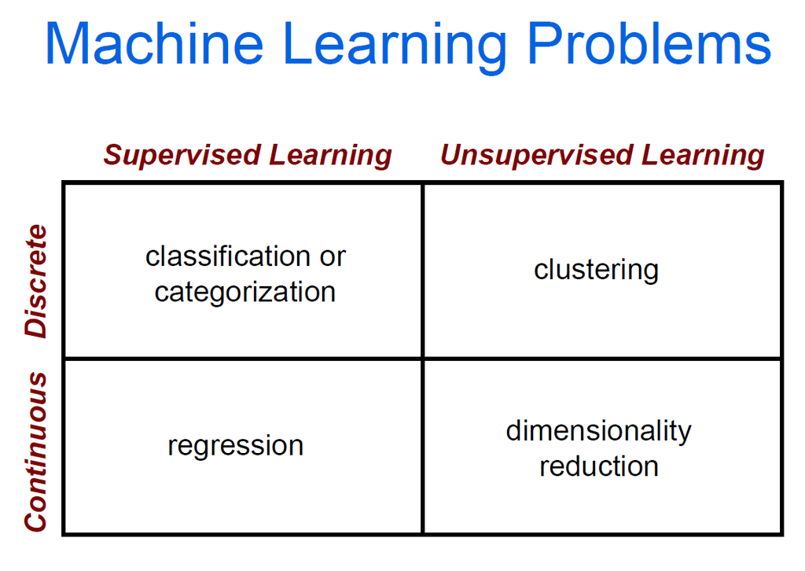
Reinforcement Learning

Slide 22
Classification: Applications
Aka Pattern recognition
Face recognition: Pose, lighting, occlusion (glasses, beard), make-up, hair style
Character recognition: Different handwriting styles.
Speech recognition: Temporal dependency.
Medical diagnosis: From symptoms to illnesses
Biometrics: Recognition/authentication using physical and/or behavioral characteristics: Face, iris, signature, etc
Outlier/novelty detection:

Slide 23








Face Recognition
Training examples of a person
Test images
ORL dataset,
AT&T Laboratories, Cambridge UK

Slide 24
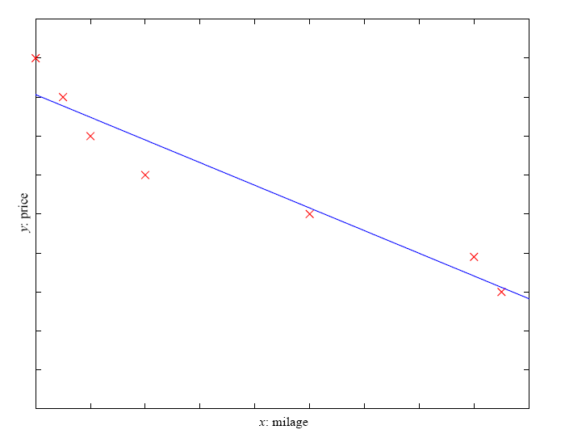
Regression
Example: Price of a used car
x : car attributes
y : price
y = g (x | θ )
g ( ) model,
θ parameters
y = wx+w₀

Slide 25
Traditional Programming
Machine Learning
Data
Computer
Output
Program
Data
Computer
Program
Output

Slide 26
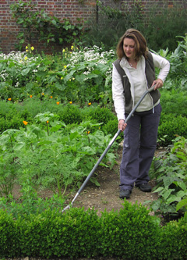
Magic?
No, more like gardening
Seeds = Algorithms
Nutrients = Data
Gardener = You
Plants = Programs

Slide 27
Sample Applications
Self-driving cars
Voice recognition, machine translation
Robotics
Web search
Computational biology
Finance
E-commerce
Space exploration
Information extraction
Social networks
Debugging
[Your favorite area]

Slide 28
ML in a Nutshell
Tens of thousands of machine learning algorithms
Hundreds new every year
Every machine learning algorithm has three components:
  Representation
  Evaluation
  Optimization

Slide 29
Representation
Decision trees
Sets of rules / Logic programs
Instances
Graphical models (Bayes/Markov nets)
Neural networks
Support vector machines
Model ensembles
Etc.

Slide 30
Evaluation
Accuracy
Precision and recall
Squared error
Likelihood
Posterior probability
Cost / Utility
Margin
Entropy
K-L divergence
Etc.

Slide 31
Optimization
Combinatorial optimization
  E.g.: Greedy search
Convex optimization
  E.g.: Gradient descent
Constrained optimization
  E.g.: Linear programming

Slide 32
What We’ll Cover
Supervised learning
  Decision tree induction
  Rule induction
  Instance-based learning
  Bayesian learning
  Neural networks (deep learning)
  Support vector machines
  Model ensembles
  Learning theory
Unsupervised learning
  Clustering
  Dimensionality reduction
Deep learning
Reinforcement learning
LLM learning and reasoning

Slide 33
ML in Practice
Understanding domain, prior knowledge, and goals
Data integration, selection, cleaning,
pre-processing, etc.
Learning models
Interpreting results
Consolidating and deploying discovered knowledge
Loop

Slide 34



The machine learning framework
Apply a prediction function to a feature representation of the image to get the desired output:
f( ) = “apple”
f( ) = “tomato”
f( ) = “cow”
Slide credit: L. Lazebnik

Slide 35
The machine learning framework
y = f(x)
Training: given a training set of labeled examples {(x₁,y₁), …, (x_{N},y_{N})}, estimate the prediction function f by minimizing the prediction error on the training set
Testing: apply f to a never before seen test example x and output the predicted value y = f(x)
output
prediction function
Image feature
Slide credit: L. Lazebnik

Slide 36
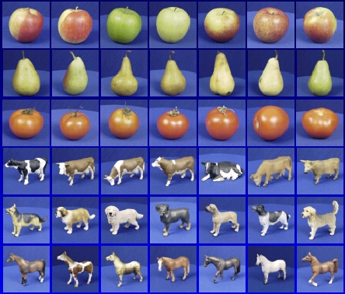

Steps
Training
Training Labels
Training Images
Image Features
Training
Learned model
Testing
Image Features
Learned model
Prediction
Test Image
Slide credit: D. Hoiem and L. Lazebnik

Slide 37
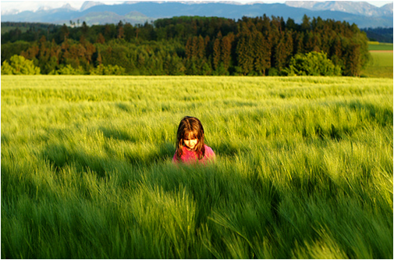
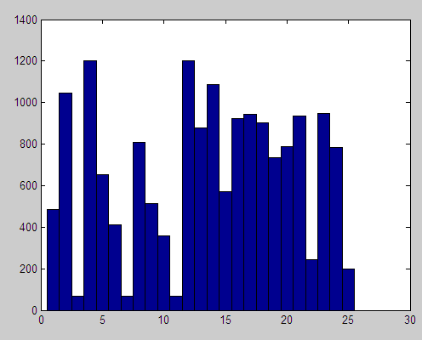
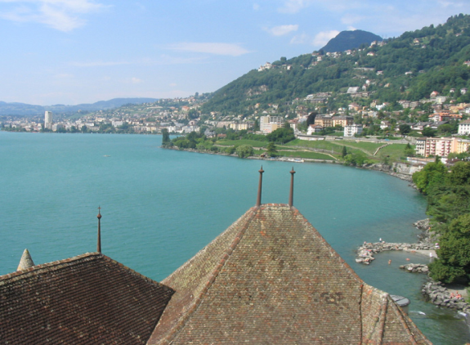
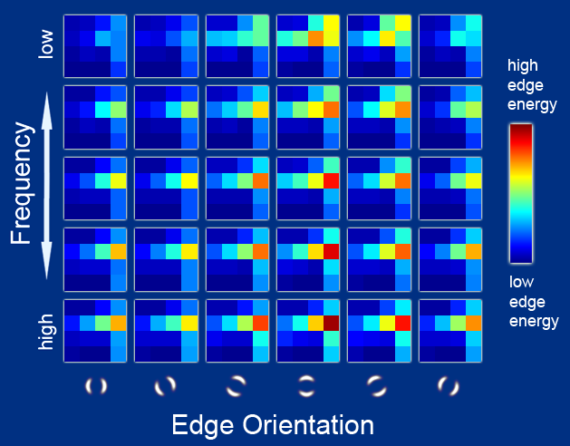
Features
Raw pixels
Histograms
GIST descriptors
…
Slide credit: L. Lazebnik

Slide 38
Classifiers: Nearest neighbor
Test example
Training examples from class 2
Training examples from class 1
f(x) = label of the training example nearest to x
All we need is a distance function for our inputs
No training required!
Slide credit: L. Lazebnik

Slide 39
Classifiers: Linear
Find a linear function to separate the classes:
f(x) = sgn(w ⋅ x + b)
Slide credit: L. Lazebnik

Slide 40
Many classifiers to choose from
SVM
Neural networks
Naïve Bayes
Bayesian network
Logistic regression
Randomized Forests
Boosted Decision Trees
K-nearest neighbor
RBMs
Etc.
Which is the best one?
Slide credit: D. Hoiem

Slide 41
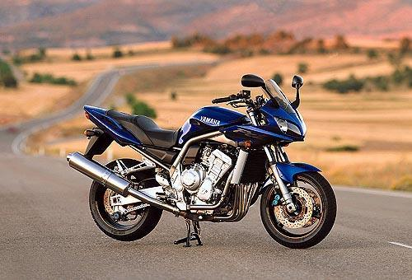
Recognition task and supervision
Images in the training set must be annotated with the “correct answer” that the model is expected to produce
Contains a motorbike

Slide 42
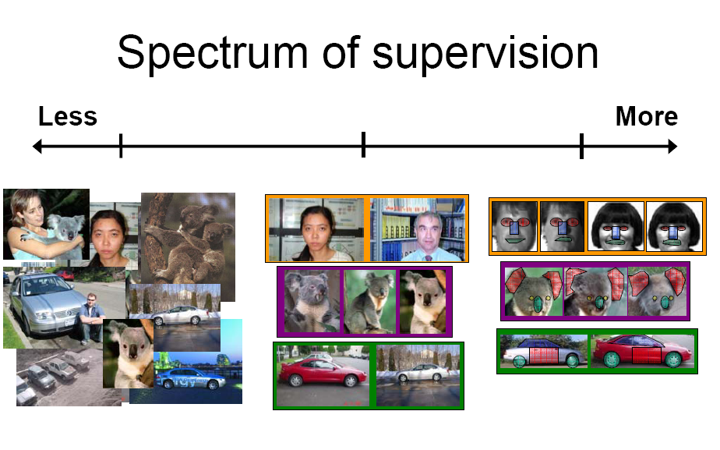
Unsupervised
“Weakly” supervised
Fully supervised
Definition depends on task
Slide credit: L. Lazebnik

Slide 43

Generalization
Training set (labels known)
Test set (labels unknown)
How well does a learned model generalize from the data it was trained on to a new test set?
Slide credit: L. Lazebnik

Slide 44
Generalization
Components of generalization error
  Bias: how much the average model over all training sets differ from the true model?
    Error due to inaccurate assumptions/simplifications made by the model
  Variance: how much models estimated from different training sets differ from each other
Underfitting: model is too “simple” to represent all the relevant class characteristics
  High bias and low variance
  High training error and high test error
Overfitting: model is too “complex” and fits irrelevant characteristics (noise) in the data
  Low bias and high variance
  Low training error and high test error
Slide credit: L. Lazebnik

Slide 45
Current Machine Learning Research
Representation
  data sequences
  spatial/temporal data
  probabilistic relational models
  …
Approaches
  ensemble methods
  cost-sensitive learning
  active learning
  semi-supervised learning
  collective classification
  …

Slide 46
Take home homework
Find 5 startup companies that use machine learning, and tell us why it is interesting
Techcrunch.com
Crunchbase.com

Slide 47
Resources: Datasets
UCI Repository: http://www.ics.uci.edu/~mlearn/MLRepository.html
Statlib: http://lib.stat.cmu.edu/

Slide 48
Resources: Journals
Journal of Machine Learning Research www.jmlr.org
Machine Learning
Neural Computation
Neural Networks
IEEE Trans on Neural Networks and Learning Systems
IEEE Trans on Pattern Analysis and Machine Intelligence
Journals on Statistics/Data Mining/Signal Processing/Natural Language Processing/Bioinformatics/...

Slide 49
Resources: Conferences
International Conference on Learning Representations (ICLR)
CVPR/ICCV
International Conference on Machine Learning (ICML)
European Conference on Machine Learning (ECML)
Neural Information Processing Systems (NIPS)
Uncertainty in Artificial Intelligence (UAI)
Computational Learning Theory (COLT)
International Conference on Artificial Neural Networks (ICANN)
International Conference on AI & Statistics (AISTATS)
International Conference on Pattern Recognition (ICPR)
...

